Slide 1




Binding Site • Binding Affinity • Visualization
Ussya Ussya ♥

Slide 2



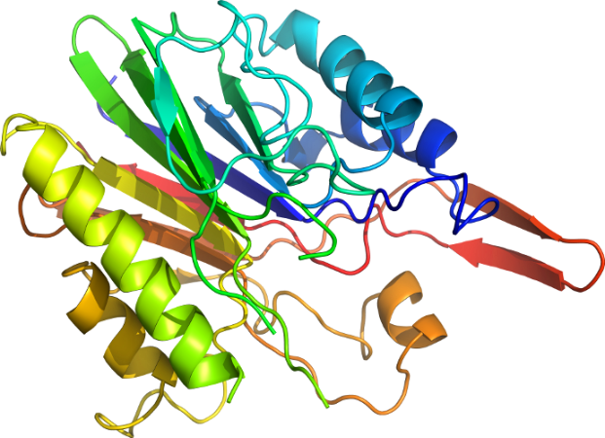


Slide 3
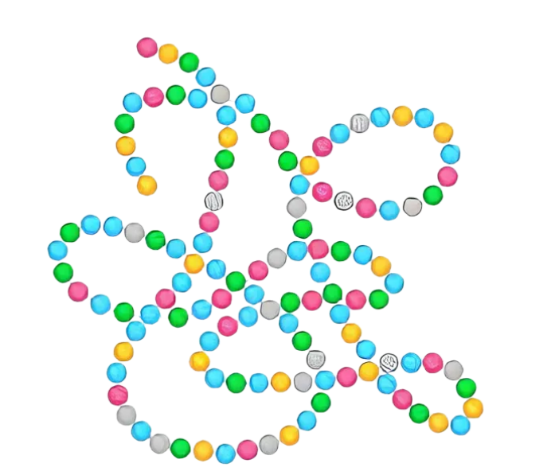
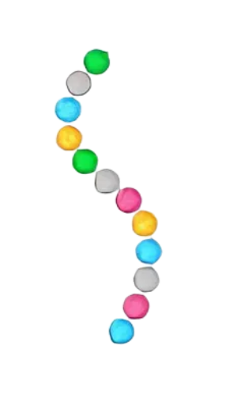
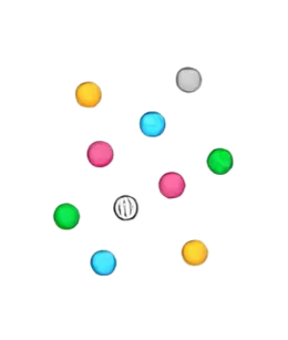

Amino Acids
(=Residue)
Peptide
Protein

Slide 4
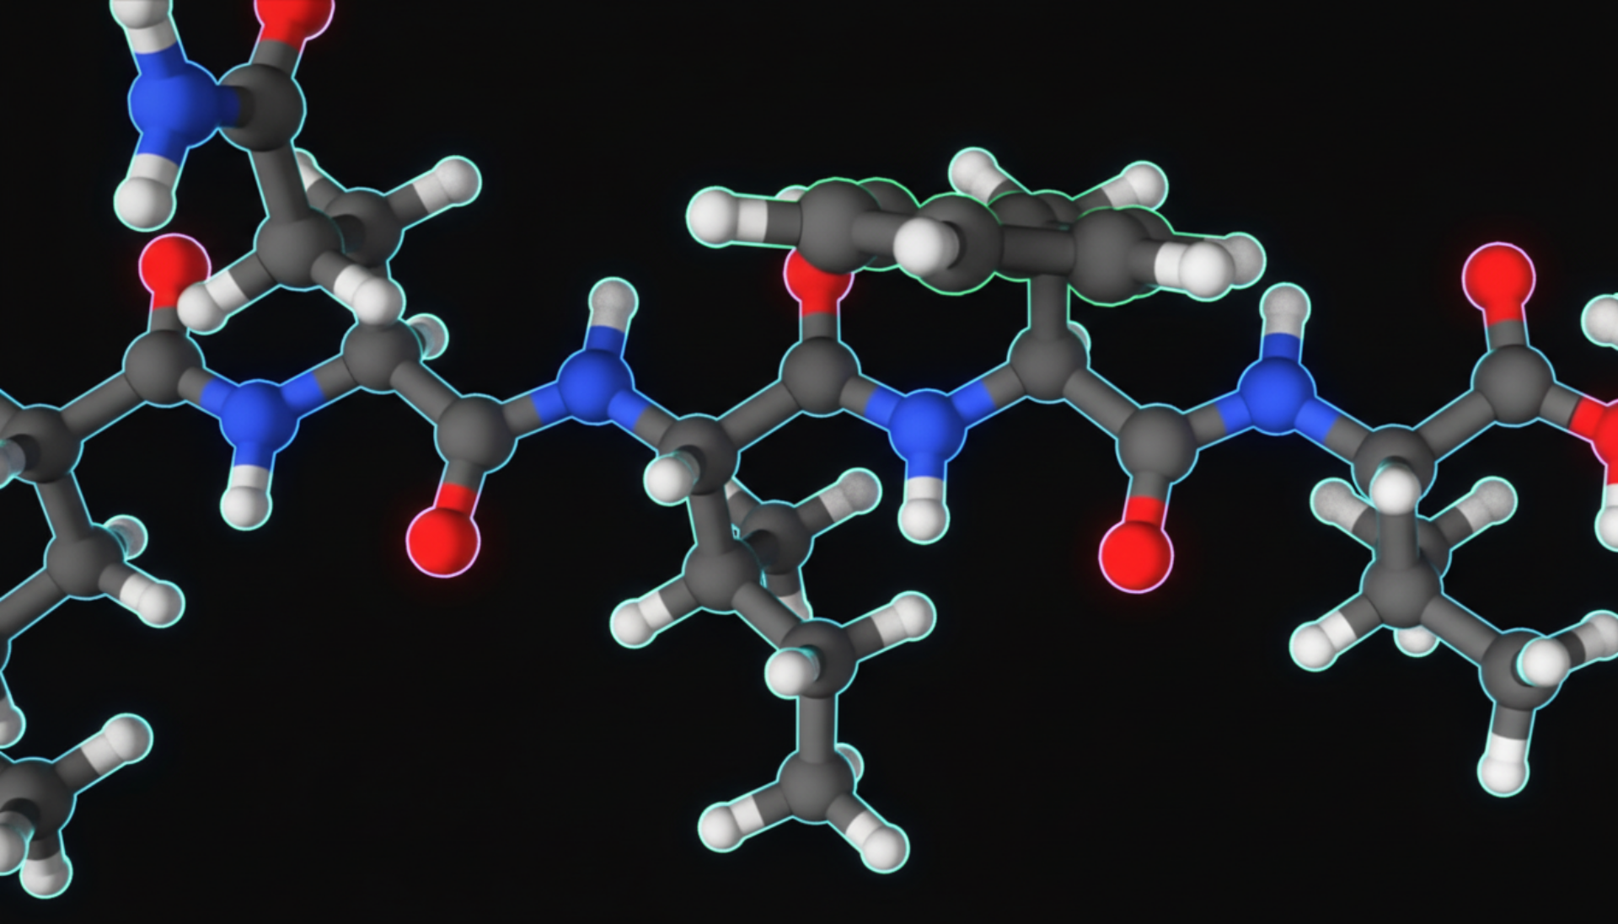










A
V
K
D
S
H
L
N
I
G

Slide 5
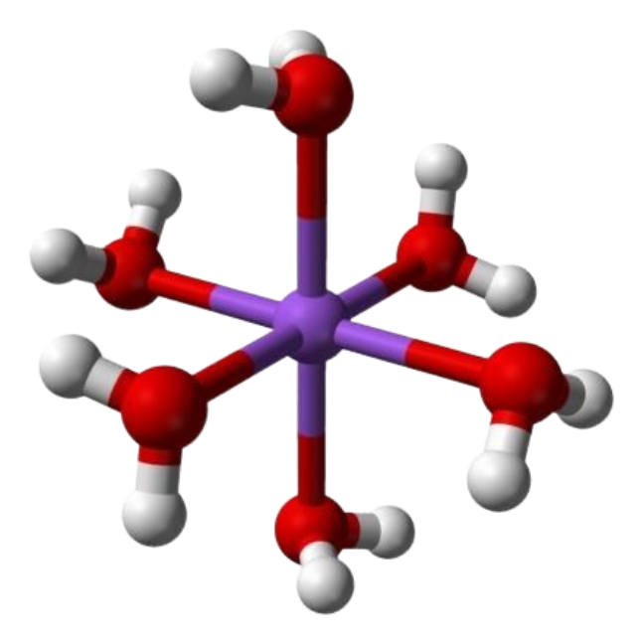

=

Slide 6
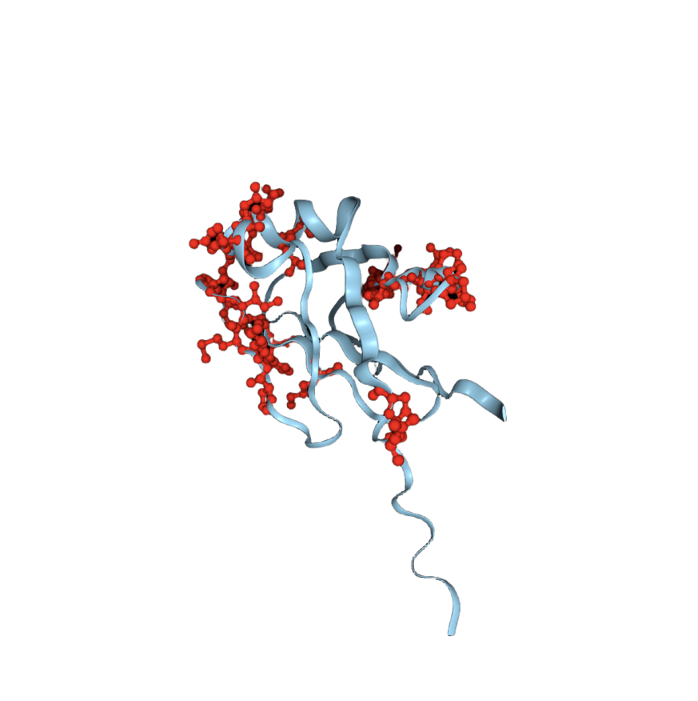



Slide 7


Slide 8



>
STGSATTTPIDSLDDAYITPVQIGTPAQT...VFNGATTPTL

Slide 9








Slide 10
PQVTLWQRPLVTIKIGGQLKEALLDTGADDTVLEEMSLPGRWKPKMIGGIGGFIKVRQYDQ
C=C8C(CCCC8)=C7

Slide 11
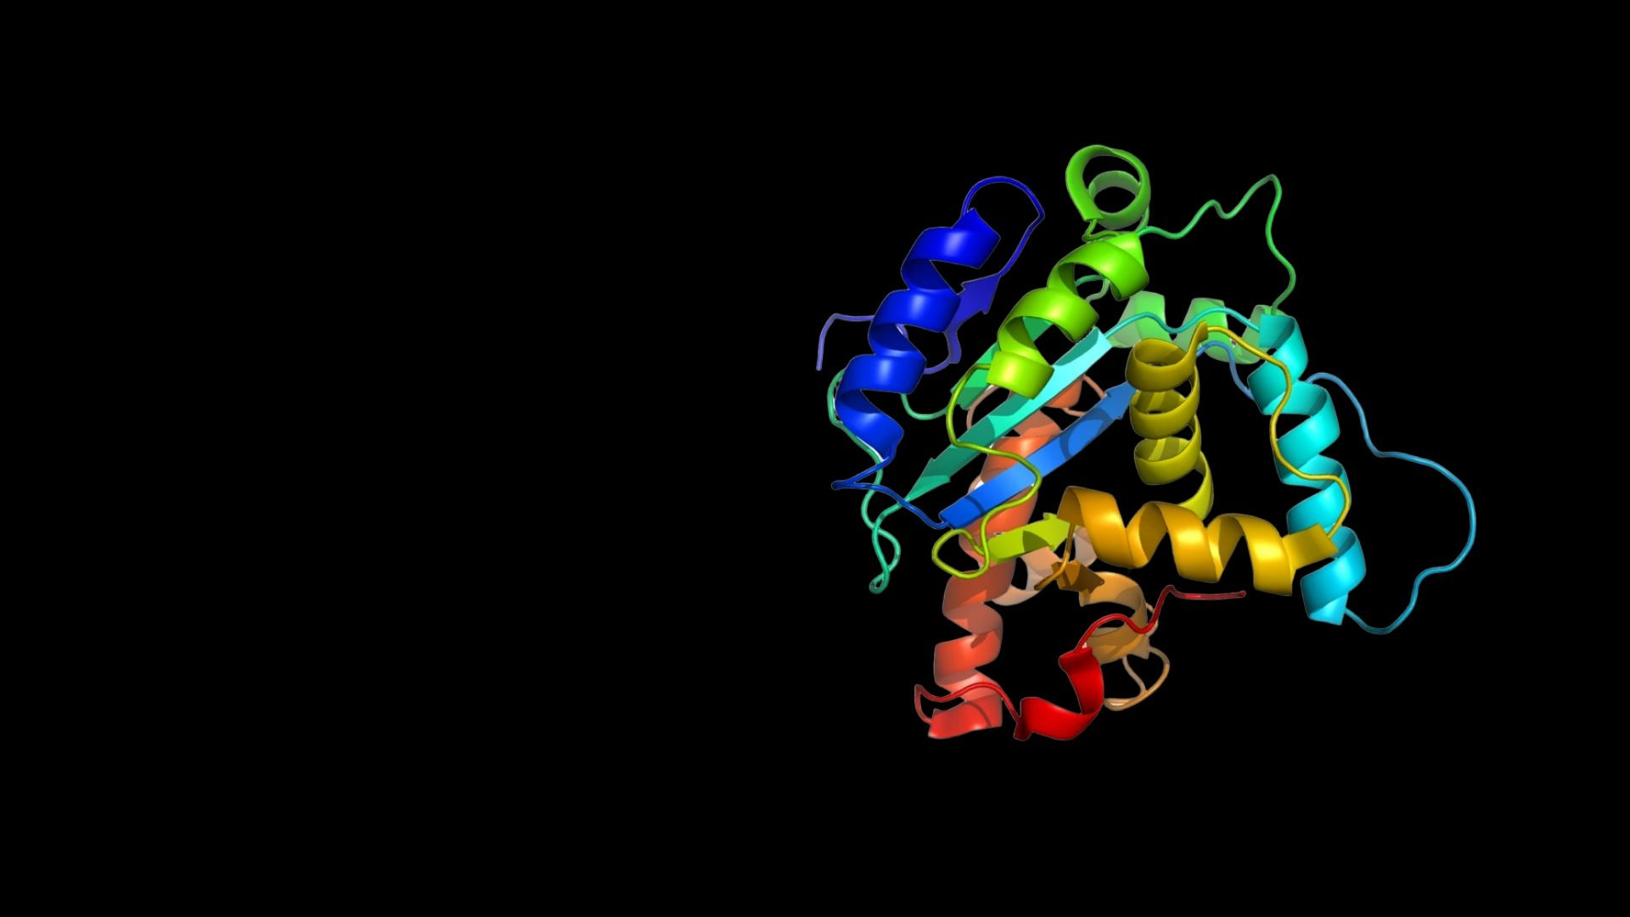

Slide 12
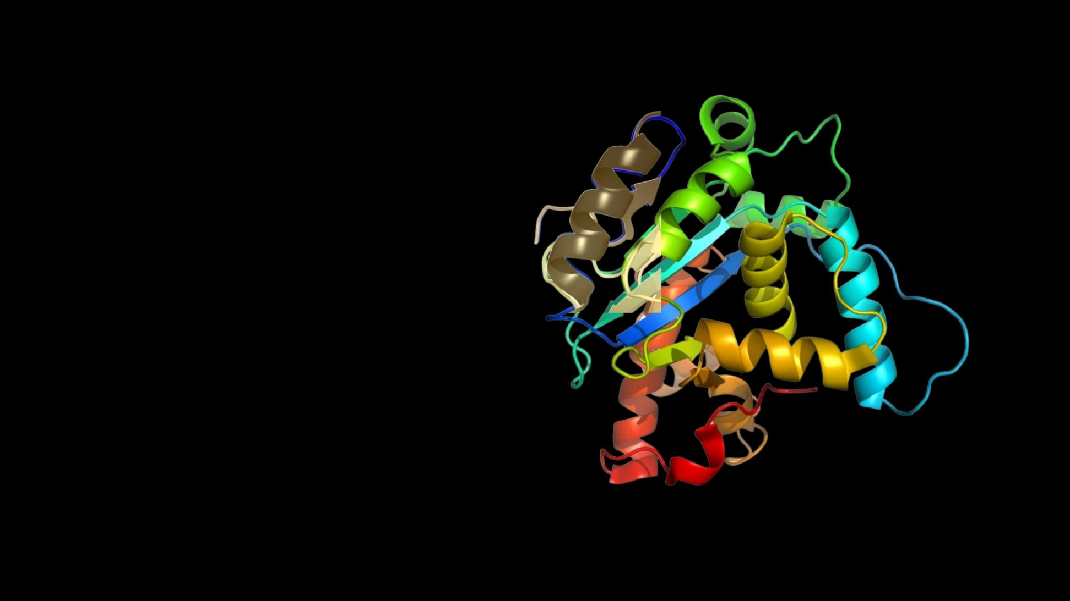

Slide 13


Slide 14




Slide 15


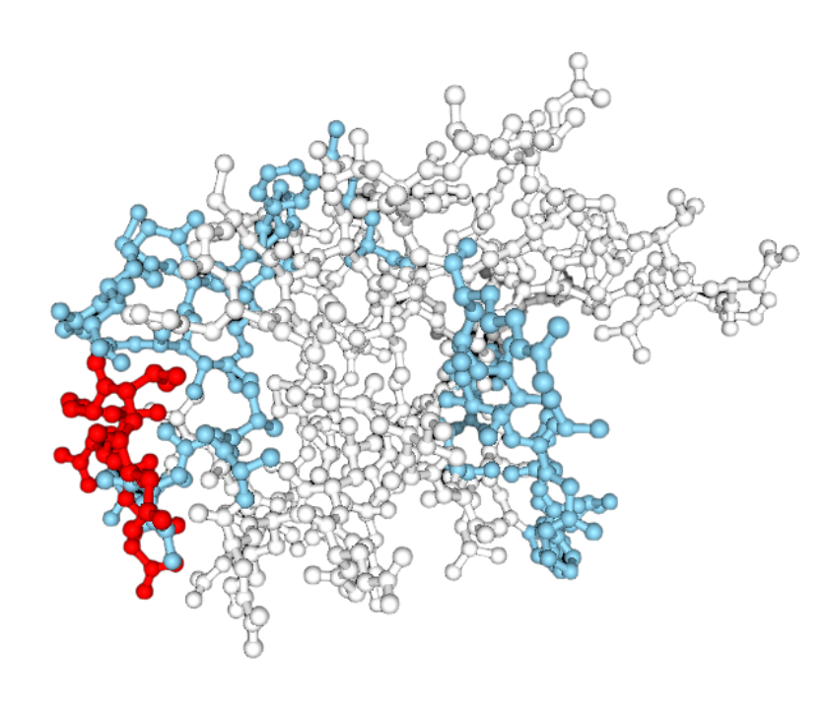




ESM-2
DenseASPP
GAP / Bottleneck

Slide 16
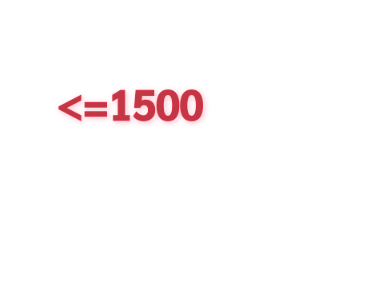




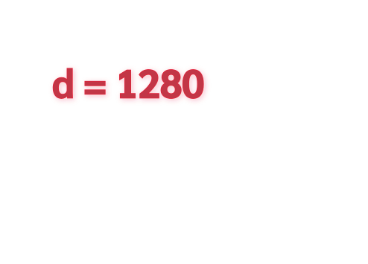









Protein Sequence
STGSATTTPIDSLDDAYITPVQIGTPAQT...VFNGATTPTL
Input Embedding from ESM
STGSATTTPIDSLDDAYITPVQIGTPAQT...VFNGATTPTL
STGSATTTPIDSLDDAYITPVQIGTPAQT...VFNGATTPTL
STGSATTTPIDSLDDAYITPVQIGTPAQT...VFNGATTPTL
STGSATTTPIDSLDDAYITPVQIGTPAQT...VFNGATTPTL
Global Representation
(after GAP)

Slide 17














STGSATTTPIDSLDD...NGATTPTL
STGSATTTPIDSLDD...NGATTPTL
STGSATTTPIDSLDD...NGATTPTL
STGSATTTPIDSLDD...NGATTPTL
BottleNeck
BottleNeck
Conv1d
(k=3, d=1, 256)
Conv1d
(k=5, d=2, 256)
Concat
BottleNeck
BottleNeck
BottleNeck
Conv1d
(k=3, d=2, 256)
Conv1d
(k=5, d=4, 256)
Conv1d
(k=1, 128)
BottleNeck
BottleNeck
Conv1d
(k=3, d=3, 256)
Conv1d
(k=5, d=6, 256)

Slide 18




Projection
(Conv1d)
Projection
(Conv1d)
Projection
(Conv1d)
STGSATTTPIDSLDD...NGATTPTL
STGSATTTPIDSLDD...NGATTPTL
STGSATTTPIDSLDD...NGATTPTL
STGSATTTPIDSLDD...NGATTPTL
MLP

Slide 19




HOLO4K
COACH420
Same Data Preprocessing as Pseq2Sites
References
Pseq2Sites
Difference
CNN + Attention

Slide 20

♥ Precision

Slide 21

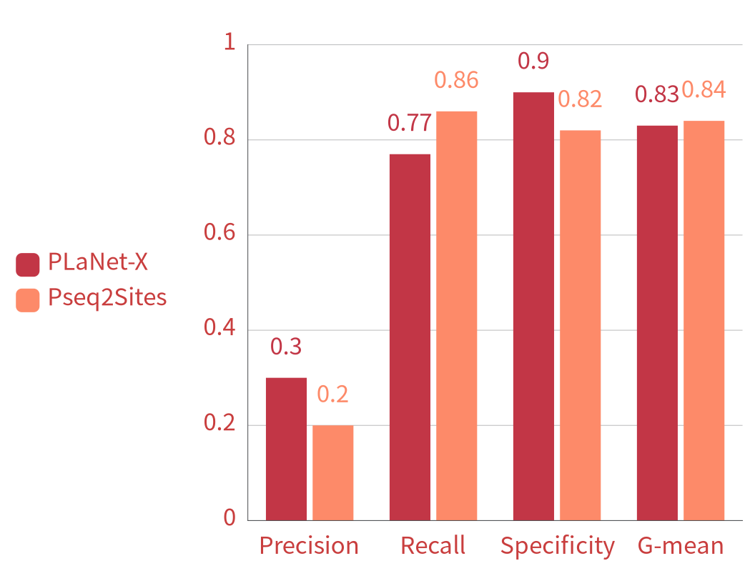

Slide 22

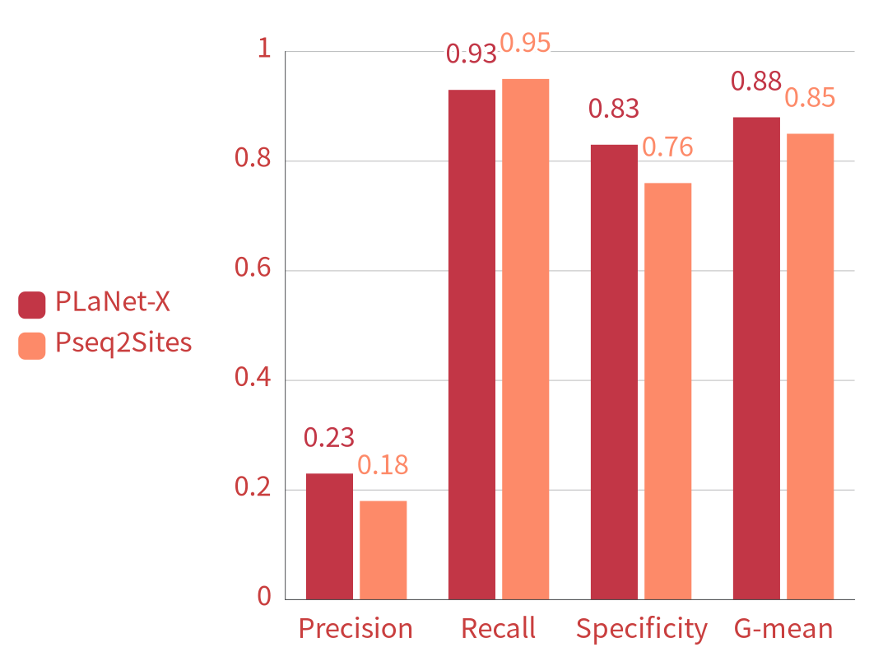

Slide 23
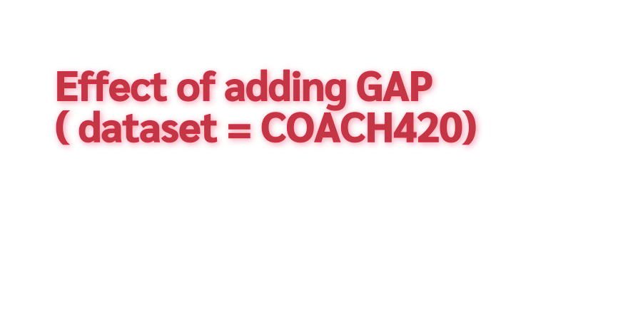
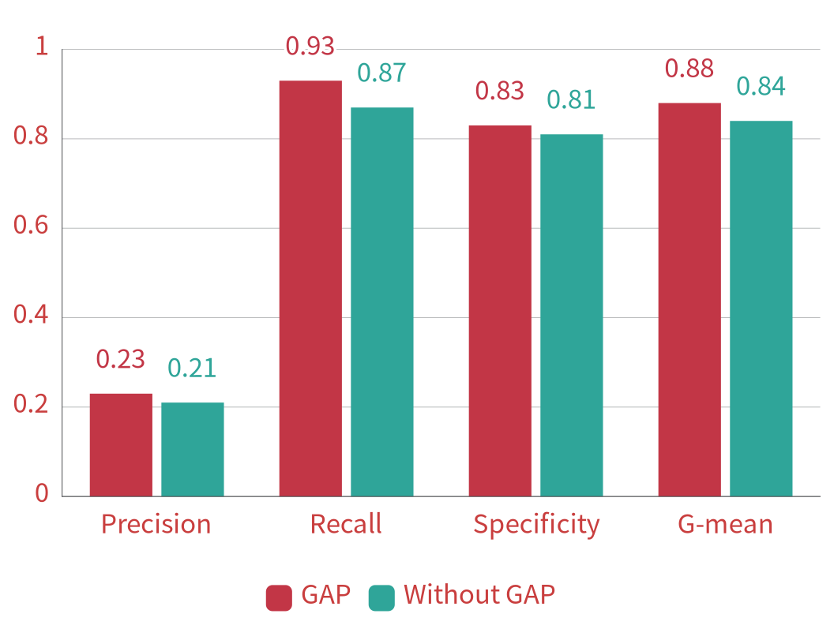

Slide 24


ESM-2 / ChemBERTa + PhysChem
DilatedCNN
Cross Attention

Slide 25
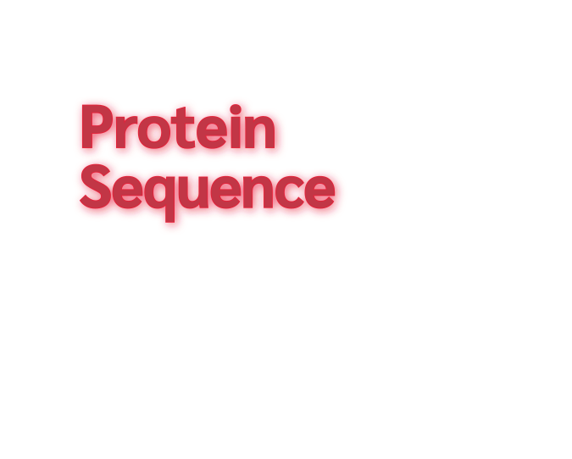
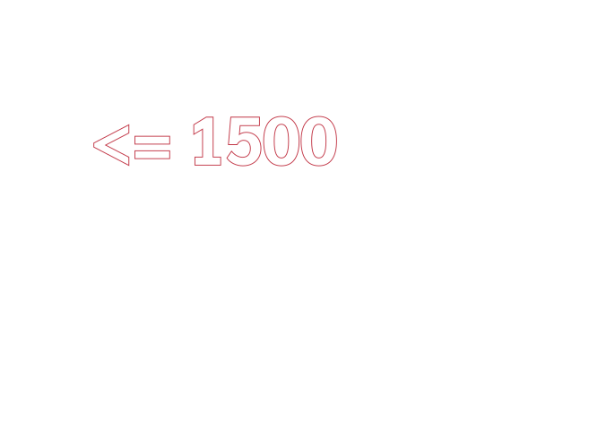




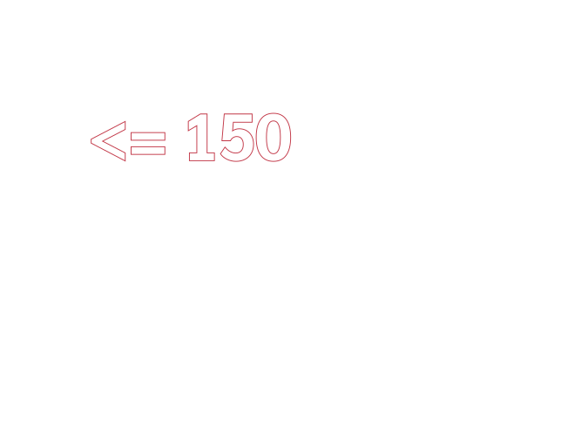




STGSATTTPIDSLDQT...VFNGATTPTL
CC(=O)OC1=CC=CC=C1C(=O)O

Slide 26



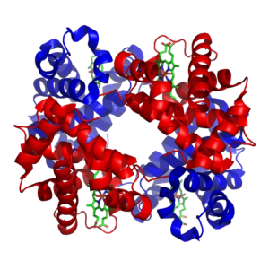

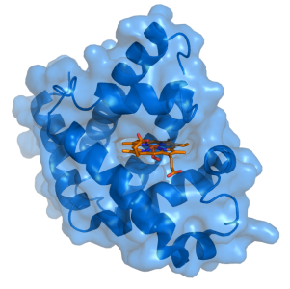



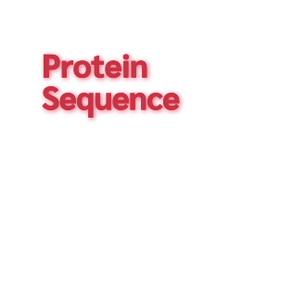
















ESM-2
Physicochemical Properties
ChemBERTa
Physicochemical Properties
Linear
Linear gating &
Linear projection
DilatedconBlock
(d = 1, 2, 3, 4)
Masked average pooling
STGSATTTPIDSLDQT...VFNGATTPTL
AdaptiveMaxPool1d
CC(=O)OC1=CC=CC=C1C(=O)O

Slide 27


Core-2016
CASF-2013
CSAR-HIQ 36
CSAR-HIQ 51
CAPLA & DeepDTAF
Slight data size difference
(preprocessing)
BS information
IGN
References
structure based
CAPLA

Slide 28


♥ R
♥ RMSE
♥ MAE

Slide 29












1.35
1.4
1.2
1.0
0.8
0.6
0.4
0.2
0
1.28
1.22
1.20
1.07
1.01
0.96
0.94
0.84
0.83
0.81
0.78
♥ R
♥ RMSE
♥ MAE
Planet-X
(N = 279)
CAPLA
(N = 290)
IGN
(N = 262)
DeepDTAF
(N = 290)

Slide 30













2.10
2.0
1.5
1.0
0.5
0
1.73
1.52
1.44
1.37
1.22
1.15
1.03
0.77
0.83
0.73
0.60
♥ R
♥ RMSE
♥ MAE
Planet-X
(N = 180)
CAPLA
(N = 195)
IGN
(N = 95)
DeepDTAF
(N = 195)

Slide 31
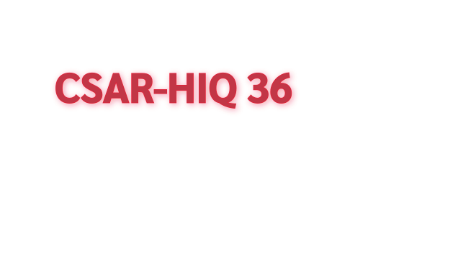










2.76
2.31
2.0
1.5
1.0
0.5
0
1.79
1.54
1.45
1.43
1.42
1.16
1.12
0.69
0.70
0.52
♥ R
♥ RMSE
♥ MAE
Planet-X
CAPLA
IGN
DeepDTAF

Slide 32












2.26
2.27
2.0
1.5
1.0
0.5
0
1.84
1.86
1.71
1.58
1.55
1.24
0.75
0.68
0.60
0.41
♥ R
♥ RMSE
♥ MAE
Planet-X
(N = 45)
CAPLA
IGN
DeepDTAF

Slide 33




















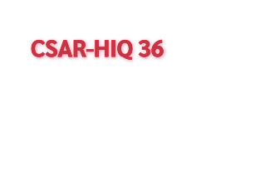
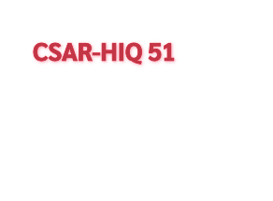


















1.4
1.2
1.0
0.8
0.6
0.4
0.2
0
2.0
1.5
1.0
0.5
0
1.28
1.20
1.22
1.52
1.44
1.37
1.01
0.96
0.94
1.22
0.84
0.83
1.15
0.81
1.03
0.77
0.83
0.73
Planet-X
(N = 279)
CAPLA
(N = 290)
IGN
(N = 262)
DeepDTAF
(N = 290)
Planet-X
(N = 180)
CAPLA
(N = 195)
IGN
(N = 95)
DeepDTAF
(N = 195)
♥ R
♥ RMSE
♥ MAE
2.26
2.0
1.5
1.0
0.5
0
1.79
2.0
1.5
1.0
0.5
0
1.84
1.58
1.71
1.42
1.45
1.43
1.55
1.12
1.16
1.24
0.69
0.70
0.75
0.68
0.52
0.41
Planet-X
CAPLA
IGN
DeepDTAF
Planet-X
(N = 45)
CAPLA
IGN
DeepDTAF

Slide 34










2.10
1.4
1.2
1.0
0.8
0.6
0.4
0.2
0
1.35
2.0
1.5
1.0
0.5
0
1.73
1.28
1.52
1.07
1.01
1.22
0.81
0.78
0.73
0.60
Planet-X
(N = 279)
CAPLA
(N = 290)
IGN
(N = 262)
DeepDTAF
(N = 290)
Planet-X
(N = 180)
CAPLA
(N = 195)
IGN
(N = 95)
DeepDTAF
(N = 195)
2.76
♥ R
♥ RMSE
♥ MAE
2.31
2.27
2.0
1.5
1.0
0.5
0
2.0
1.5
1.0
0.5
0
1.86
1.54
1.58
1.42
1.12
1.24
0.69
0.75
0.60
Planet-X
CAPLA
IGN
DeepDTAF
Planet-X
(N = 45)
CAPLA
IGN
DeepDTAF

Slide 35
2.10
1.4
1.2
1.0
0.8
0.6
0.4
0.2
0
1.35
2.0
1.5
1.0
0.5
0
1.73
1.28
1.20
1.22
1.52
1.07
1.44
1.37
1.01
0.96
0.94
1.22
1.15
0.81
0.84
0.83
1.03
0.78
0.77
0.83
0.73
0.60
Planet-X
(N = 279)
CAPLA
(N = 290)
IGN
(N = 262)
DeepDTAF
(N = 290)
Planet-X
(N = 180)
CAPLA
(N = 195)
IGN
(N = 95)
DeepDTAF
(N = 195)
♥ R
♥ RMSE
♥ MAE
2.76
2.31
2.27
2.26
2.0
1.5
1.0
0.5
0
1.79
2.0
1.5
1.0
0.5
0
1.84
1.86
1.54
1.58
1.71
1.42
1.45
1.43
1.55
1.12
1.16
1.24
0.69
0.70
0.75
0.68
0.52
0.60
0.41
Planet-X
CAPLA
IGN
DeepDTAF
Planet-X
(N = 45)
CAPLA
IGN
DeepDTAF

Slide 36

Demonstration
Video

Slide 37


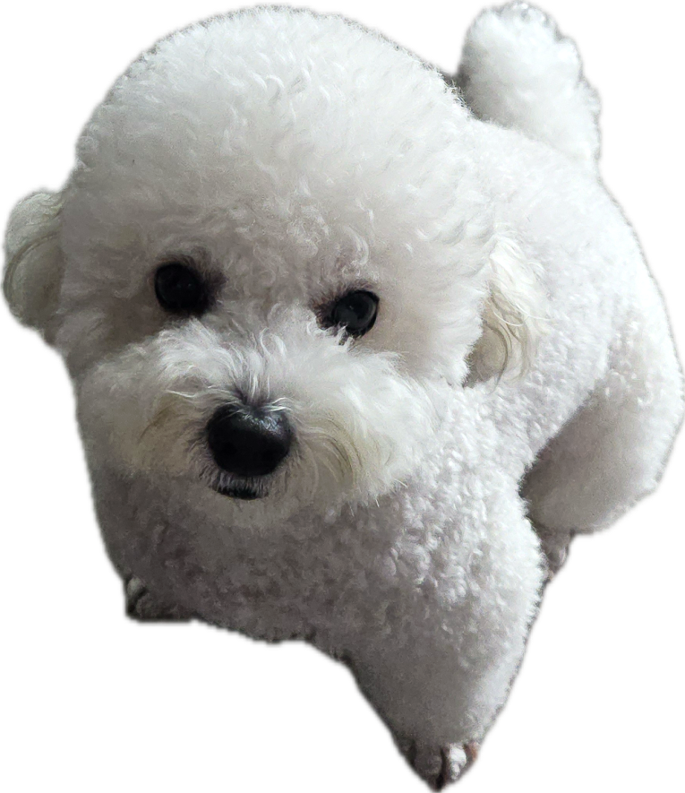

Ussya Ussya ♥
END

